Slide 1







Agentic Ethereum
Hackathon India
Empowering India to lead the Web3 AI evolution with decentralized agents on Ethereum.
__________________________
Team Name: G.O.A.T
Members:
Tharshananth N
Mithilesh Kumar U S
Hemanth S
Sreyas S K

Slide 2
Problem statement
PROBLEM SOLUTION : DeFi Copilot
Build an AI-powered agent that automates DeFi for:
Microfinance
Rural savings
Sending money across countries
On-chain credit scoring
All using Ethereum-based protocols like Lido, Aave, Uniswap with a simple chatbot or voice assistant as the interface.
PROBLEM STATEMENT : (Theme 2)
"DeFi + Financial Inclusion Agents"
Despite the growing potential of DeFi, many users avoid or abandon it due to its technical complexity. Concepts like wallets, gas fees, staking, bridging, and platform selection are unfamiliar and overwhelming for the average user. As a result, DeFi remains largely inaccessible to non-technical individuals, limiting its widespread adoption and utility.. But with a smartphone and internet, they can access DeFi — which can help them:
Save money securely
Earn interest through staking or lending
Get loans using digital assets as collateral
Send/receive money (remittances) cheaply
Build credit scores through on-chain history
UNIQUE VALUES :
Most apps show data — your app acts on it for the user (agentic).
It doesn’t just let you stake or lend — it chooses the best platform and executes it.
It teaches new users along the way → makes DeFi friendly for non-tech users.
Bridges AI + DeFi to create hands-free finance on Ethereum.
Agentic Ethereum Hackathon India 2025
Notes:
2

Slide 3
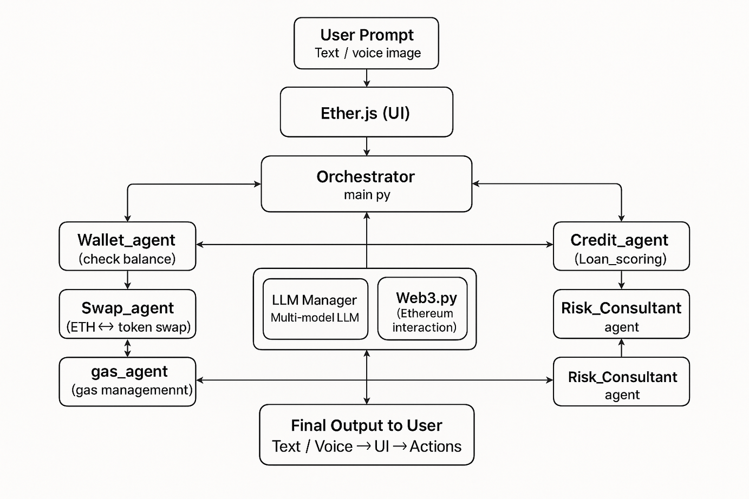
Technical Approach
PROCESS FLOW ARCHITECTURE:
Our Case Study: https://docs.google.com/document/d/1iFIyslueVLr3oMoPWltL_H_aQBWMM4ej/edit?tab=t.0
GITHUB LINK:(.README file)
https://github.com/Tharshananth/AgenticEthereumHackathonIndia/tree/main
Agentic Ethereum Hackathon India 2025
3
Notes:
3

Slide 4
Feasibilitty
Technical Feasibility:
Proven Technologies:
Built on Ethereum with EVM-based DeFi protocols (Lido, Aave, Uniswap).
Uses Web3.py / Ethers.js for blockchain access and intraction with etherium .
open source multi-model LLM from huggingface ,web3 for blockchain interaction.
Moderate Complexity:
Developed with open-source tools (Huggingface, LangGraph, web3.py).
Modular agent architecture (wallet, swap, bridge, gas, etc.) ensures clear separation of concerns.
LLM orchestrator reduces complexity while enabling intelligent automation.
Scalable:
P2P and decentralized design supports easy horizontal scaling.
Agents are plug-and-play, enabling seamless integration of new chains or features.
POTENTIAL CHALLENGES AND RISKS:
Technical:
Scalability: Handling a growing user base and P2P network efficiently.
Latency: less inference
compactablity: powerfull GPU
Case Study:
Copilot in Action:
We've created a document that demonstrates how our Copi lot performs and interacts with users in different scenarios.
doc: case_study
Agentic Ethereum Hackathon India 2025
Notes:
4

Slide 5
Market readiness
POTENTIAL IMPACT :
Improved UX: Natural language prompts simplify DeFi actions (swap, stake, bridge).
Cost-Efficient: Reduces user gas fees via optimized transactions and minimizes backend costs through P2P.
Faster Decisions: Real-time insights and agent-driven analytics improve DeFi decision-making.
Scalable: Easily extendable to other sectors ( insurance, AI finance tools).
Efficient Architecture: Modular agents reduce redundancy and improve system response.
Smart Operations: Automates routine tasks like gas checks, balance fetch, and bridging.
Challenges: High reliance on smart contract security and LLM accuracy.
Go-To-Market Plan:
Target Audience:
Ideal Customer Profile: Focus on rural and low-income communities.
Community-Driven Pre-Launch:
Local Partnerships: Collaborate with NGOs, local microfinance institutions.
Trust Building:
Onboarding Incentives: Use token airdrops or small initial balances to encourage first-time users.
Unique Value:
Built-in Education: The agent teaches users as they interact, building confidence and long-term engagement.
Metrics & Feedback Loops:
Track Adoption: Monitor user growth, transaction volumes, and retention rates.
Agentic Ethereum Hackathon India 2025
Notes:
5

